Slide 1


Air- Quality-Index-Prediction
Model Using Python

Slide 2
NAME : KUDUMULA TRIVENI
STUDENT ID : STU6798f9d7c11551738078679
COLLEGE : SRI VENKATESWARA COLLEGE
OF
ENGINEERING AND TECHNOLOGY

Slide 3

Learning Objectives
• Understand the factors affecting air quality.
• Learn how to preprocess air quality datasets.
• Implement machine learning models for AQI
prediction.
• Evaluate model performance and optimize
accuracy.
GOAL
Source :
www.freepik.com/

Slide 4
Tools and Technology used
• Programming Language : Python
• Libraries Pandas, NumPy, Scikit-Learn, Matplotlib , Seaborn
• IDE : Jupyter notebook / Google Colab / visual studio code
• Dataset : Historical AQI Prediction data

Slide 5
Methodology
• Data Collection: Obtain AQI datasets from reliable sources.
• Data Preprocessing: Handle missing values, outliers, and feature
engineering.
• Exploratory Data Analysis (EDA): Visualize and understand data trends.
• Model Selection: Choose algorithms like Random Forest, XGBoost, LSTM
(for time series).
• Model Training & Evaluation: Split data, train models, and test performance
using RMSE, MAE, or R² score.
• Optimization: Tune hyperparameters for better accuracy.

Slide 6
Problem Statement:
• Air pollution poses a significant threat to public health, and accurate
AQI prediction can help mitigate its impact by enabling timely I
interventions.“
• Traditional AQI monitoring methods rely on physical sensors, which
can be costly and provide delayed data.
• By leveraging Artificial Intelligence (AI) and Machine Learning (ML),
we can develop a predictive model that analyzes historical air quality
data and meteorological factors to forecast AQI in real time.

Slide 7
Solution:
• Develop an ML-based model that predicts AQI using past air quality
and meteorological data, aiding in better pollution management and
awareness.
• Leverage AI and ML to develop a predictive model that forecasts AQI
based on historical air quality and meteorological data.
• This model will help authorities and individuals take proactive
measures for pollution control, improving environmental awareness
and public health.

Slide 8
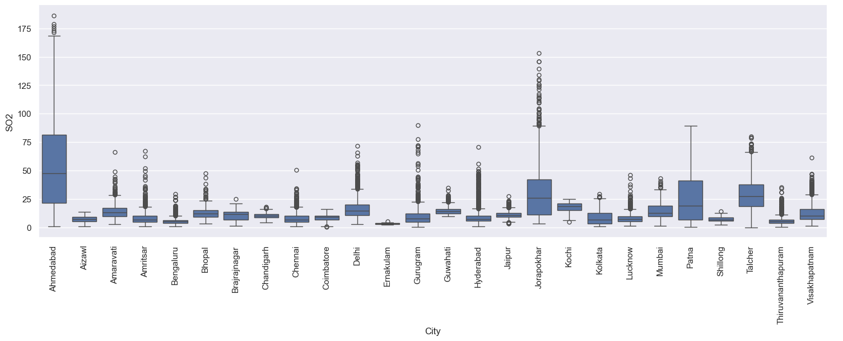
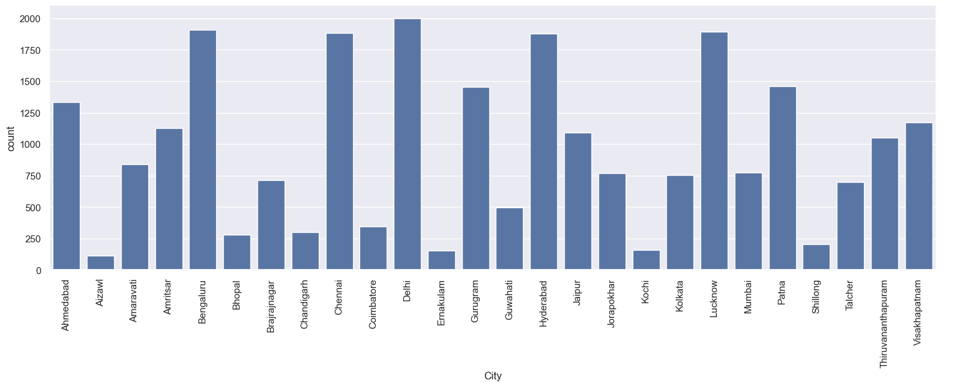
Screenshot of Output:

Slide 9

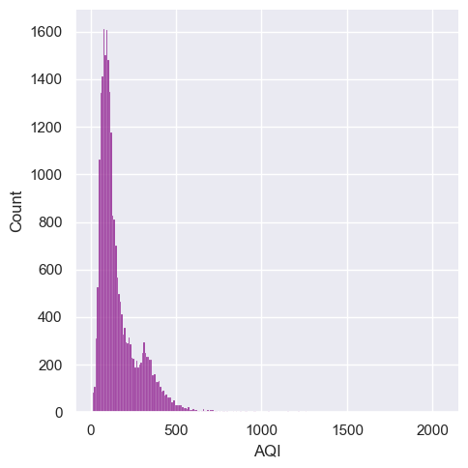
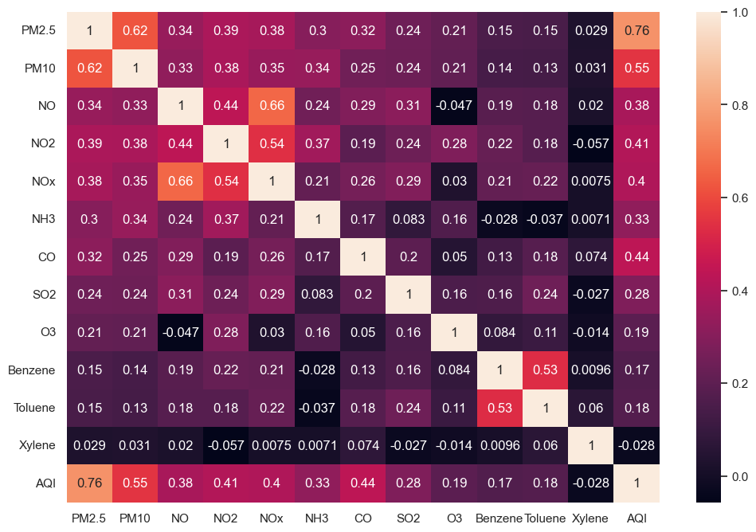
Screenshot of Output:

Slide 10
Conclusion:
• Summarize findings, accuracy of the model, and potential
improvements.
• Discuss the importance of real-time data and advanced techniques
like deep learning for future improvements.
• The development of an AI and ML-based AQI prediction model
provides an efficient way to forecast air pollution levels using
historical air quality and meteorological data

